Slide 1
Transactions and Locks

Slide 2
Data base Transactions
A transaction is a smallest grouping of one or more statements that should be considered to be all or nothing.

Slide 3
ACID
Transactions can provide four major functions to data manipulation process that access the data base.
Atomicity: states that database modifications must follow an “all or nothing” rule. Each transaction is said to be “atomic.” If one part of the transaction fails, the entire transaction fails.
Consistency: states at the end of a transaction, either a new and valid form of data exits or the data is returned to its original state.
Isolation: during a transaction (before it is committed or roll back) the data must remain in an isolated state and not to be accessible to other transactions.
Durability: after a transaction is committed, the final state of the data is still available even if the server fails or restarted.

Slide 4
Example
Imagine that you are a banker: sally comes in and wants to transfer 1000 rupees from checking to saving account.

Slide 5
Example
Atomicity: Shouldn’t take money from checking to without giving it to saving account.
Consistency: money isn’t lost or gained.
Isolation: Other queries shouldn’t see saving or checking account change until completion.
Durability: The money doesn’t go back to saving.
Update checking
Set balance = balance – 1000
Where account = ‘sally’
Update savings
Set balance = balance + 1000
Where account = ‘sally’

Slide 6
Transactions Contd…
Transactions group a set of tasks into a single execution unit.
Each transaction begins with a specific task and ends when all the tasks in the group successfully complete.
If any of the tasks fails, the transaction fails. Therefore, a transaction has only two results: success or failure. Incomplete steps result in the failure of the transaction.

Slide 7
Users can group two or more Transact-SQL statements into a single transaction using the following statements:
* Begin Transaction * Rollback Transaction * Commit Transaction

Slide 8
Begin Transaction
Marks the starting point of an explicit, local transaction. BEGIN TRANSACTION increments @@TRANCOUNT by 1.

Slide 9
Rollback Transaction
If anything goes wrong with any of the grouped statements, all changes need to be aborted. The process of reversing changes is called rollback in SQL Server terminology.
A ROLLBACK, on the other hand, works regardless of the level at which it is issued, but rolls back all transactions, regardless of the nesting level.

Slide 10
ROLLBACK TRANSACTION rolls back to the beginning of the transaction.
When nesting transactions, this same statement rolls back all inner transactions to the outermost BEGIN TRANSACTION statement.
In both cases, ROLLBACK TRANSACTION decrements the @@TRANCOUNT system function to 0.

Slide 11
A transaction cannot be rolled back after a COMMIT TRANSACTION statement is executed, except when the COMMIT TRANSACTION is associated with a nested transaction that is contained within the transaction being rolled back.
In this instance, the nested transaction will also be rolled back, even if you have issued a COMMIT TRANSACTION for it.

Slide 12
Commit Transaction
If everything is in order with all statements within a single transaction, all changes are recorded together in the database. In SQL Server terminology, we say that these changes are committed to the database.

Slide 13
Concurrency
When many people attempt to modify data in a database at the same time, a system of controls must be implemented so that modifications made by one person do not adversely affect those of another person. This is called concurrency control.

Slide 14
Concurrency Problems
Four major problems of concurrency:
Dirty Reads
Non-Repeatable Reads
Phantoms

Slide 15
Dirty Reads
Dirty reads occur when a transaction reads a record that is part of another transaction that isn’t complete
yet. If the first transaction completes normally, then it’s unlikely there’s a problem. But what if the transaction
were rolled back? You would have information from a transaction that never happened from thedatabase’s perspective!

Slide 16
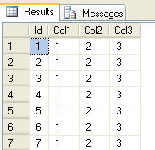
Example
--Query1
BEGIN TRAN
UPDATE IsolationTests SET Col1 = 2
WAITFOR DELAY '00:00:10'
ROLLBACK
Query2
SELECT * FROM IsolationTests

Slide 17
Non-Repeatable Reads
A non-repeatable read is caused when you read the record twice in a transaction and a separate transaction
alters the data in the interim. For this one, let’s go back to our bank example. Remember that we don’t
want the value of the account to go below 0 dollars:

Slide 18
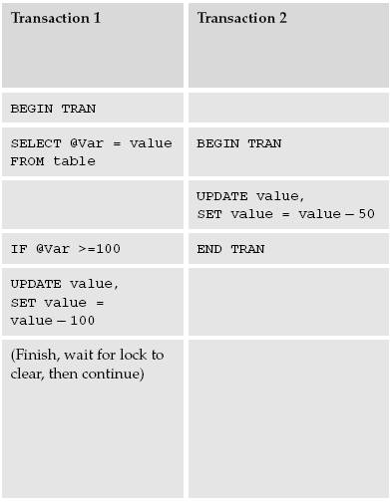
Example

Slide 19
Phantom
Occur when one transaction accesses a range of data more than once and a second transaction inserts or deletes rows that fall within that range between the first transaction's read attempts.
This can cause "phantom" rows to appear or disappear from the first transaction's perspective.
In short, someone performed an INSERT statement at the very same time your UPDATE was running.

Slide 20
Example
UPDATE HumanResources
SET HourlyRate = 7.50
WHERE HourlyRate < 7.50;
Insert into HumanResources
Values (6.50)

Slide 21
Physical Storage Hierarchy of Database
Highest level of storage Database 10GB
Extent 64Kb
Pages 8Kb
Rows

Slide 22
Locks and Isolation levels
In order to deal with concurrency problems in database locks and isolation levels are used.
Locks are a mechanism for preventing a process from performing an action on an object that conflicts with something already being done to that object.
Isolation levels in SQL Server control the way locking works between transactions.

Slide 23
Example

Slide 24
Types of Locks
Shared Locks: Used for operations that do not change or update data (read-only operations), such as a SELECT statement.
Exclusive Locks: Used for data-modification operations, such as INSERT, UPDATE, or DELETE. Ensures that multiple updates cannot be made to the same resource at the same time.
Update Locks: Update locks are something of a hybrid between shared locks and exclusive locks.

Slide 25
Locks
SQL Server handles all locking decisions. It chooses which type of lock to use after it determines the query plan. However, the way you write a query or transaction can affect the type of lock the server chooses. You can also force the server to make certain locks more or less restrictive by changing the transaction's isolation level.

Slide 26
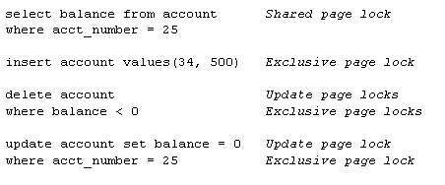
Examples
The following examples show what kind of page locks SQL Server uses for the respective statement :

Slide 27
Command to check current isolation level of :
“DBCC useroptions”
Command to set an isolation level:
SET TRANSACTION ISOLATION LEVEL <level>

Slide 28
Isolation Levels
READ UNCOMMITTED is the most dangerous of all isolation level choices, but also has the highest performance in terms of speed. Setting the isolation level to READ UNCOMMITTED tells SQL Server not to set any locks and not to honor any locks.
With this isolation level, it is possible to experience any of the various concurrency issues we discussed earlier in the lecture.

Slide 29
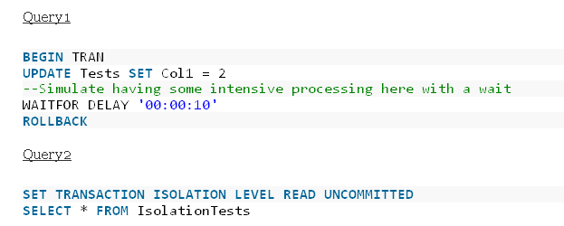
Example

Slide 30
Read committed
READ COMMITTED (default): This is the default isolation level and means selects will only return committed data. Select statements will issue shared lock requests against data you’re querying this causes you to wait if another transaction already has an exclusive lock on that data. Once you have your shared lock any other transactions trying to modify that data will request an exclusive lock and be made to wait until your Read Committed transaction finishes.

Slide 31
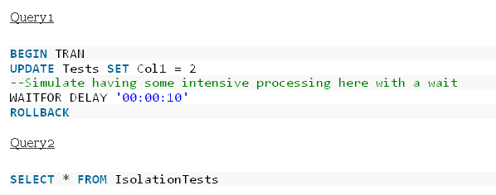
Example

Slide 32
Repeatable Read
The REPEATABLE READ escalates your isolation level somewhat and provides an extra level of concurrency protection.
That prevention of non-repeatable reads is a big upside, but holding even shared locks until the end of the transaction can block users’ access to objects,

Slide 33
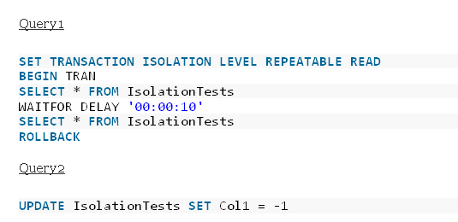
Example

Slide 34
SERIALIZABLE
SERIALIZABLE is something of the fortress of isolation levels. It prevents all forms of concurrency issues.
When you set your isolation to SERIALIZABLE, you’re saying that any UPDATE, DELETE, or INSERT to the table or tables used by your transaction must not meet the WHERE clause of any statement in that transaction.
Essentially, if the user was going to do something that your transaction would be interested in, then it must wait until your transaction has been completed.

Slide 35
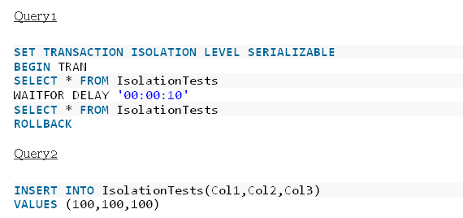
Example

